Slide 1

Applied Machine Learning
Group Project:
‘SPOILER ALERT!!!’
Group 2
GOH JUN LIN, LI ZUXIAN, HONG KAIYUAN, FUNG HONG KIT

Slide 2
ISSS610 Applied Machine Learning
Project Proposal
Problem
Problem Statement
Auto-detection of spoiler contents in users’ reviews in IMDB
Impact of Spoiler
Affect user experience
May reduce the intention of viewing or buying movies from IMDB
May reduce the revenue of buying movie from IMDB
Group 2 | 25 Feb 2020

Slide 3
ISSS610 Applied Machine Learning
Project Proposal
Assumption
IMDB wants to improve the client experience and would like to tag all the potential spoilers
The original labels are based on users' subjective opinions
The review text is largely in proper English
Group 2 | 25 Feb 2020

Slide 4
ISSS610 Applied Machine Learning
Project Proposal
Dataset
IMDB_reviews.json (573,913 data)
IMDB_movie_details.json (1,572 data)
Attributes | Description
review_date | Date the review was written
movie_id | Unique ID of movie
user_id | Unique ID of the user that wrote the review
is_spoiler | Indicates if the review contains spoiler content
review_text | User review about the movie
rating | Rating given by the user on the movie
review_summary | Short summary of the review
Attributes | Description
movie_id | Unique ID of movie
plot_summary | Plot summary of the movie
duration | Runtime duration
genre | Associated genres
rating | Overall rating
release_date | The release date of the movie
plot_synopsis | Synopsis of item's plot

Slide 5
ISSS610 Applied Machine Learning
Project Proposal
Dataset - IMDB_reviews.json
Group 2 | 25 Feb 2020

Slide 6
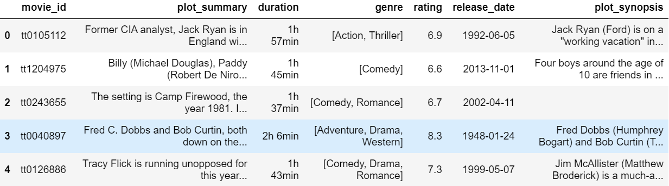
ISSS610 Applied Machine Learning
Project Proposal
Dataset - IMDB_movie_details.json
Group 2 | 25 Feb 2020

Slide 7
ISSS610 Applied Machine Learning
Project Proposal
Datasets – Movie Breakdown by Genre
Group 2 | 25 Feb 2020
Notes:
Kaiyuan:
This slide aims to give the audience a flavour of our dataset.
All movies have between 1 and 3 genres.
If a movie has three genres, it’s count would be included in all three genres.

Slide 8
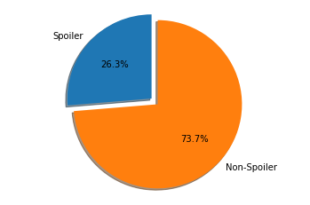
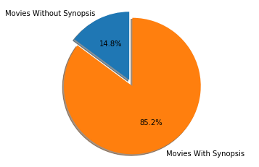
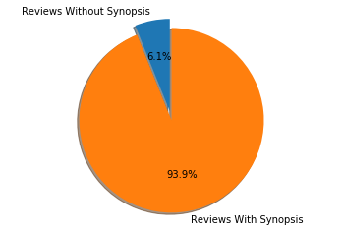


ISSS610 Applied Machine Learning
Project Proposal
Datasets – Weights & Missing Data

Slide 9
ISSS610 Applied Machine Learning
Project Proposal
Data-Preprocessing
Corrected typos in movie ID
Merge movie dataset and review dataset
Remove missing data (reviews and movies without plot synopsis)
Group 2 | 25 Feb 2020

Slide 10
ISSS610 Applied Machine Learning
Project Proposal
Data-Preprocessing
Tokenization of the review texts and the plot synopsis
Lower Case
Remove Punctuations, Special Characters, Numbers
Remove words less than 2 characters
Remove Stop Words
Perform Lemmatization
Group 2 | 25 Feb 2020

Slide 11
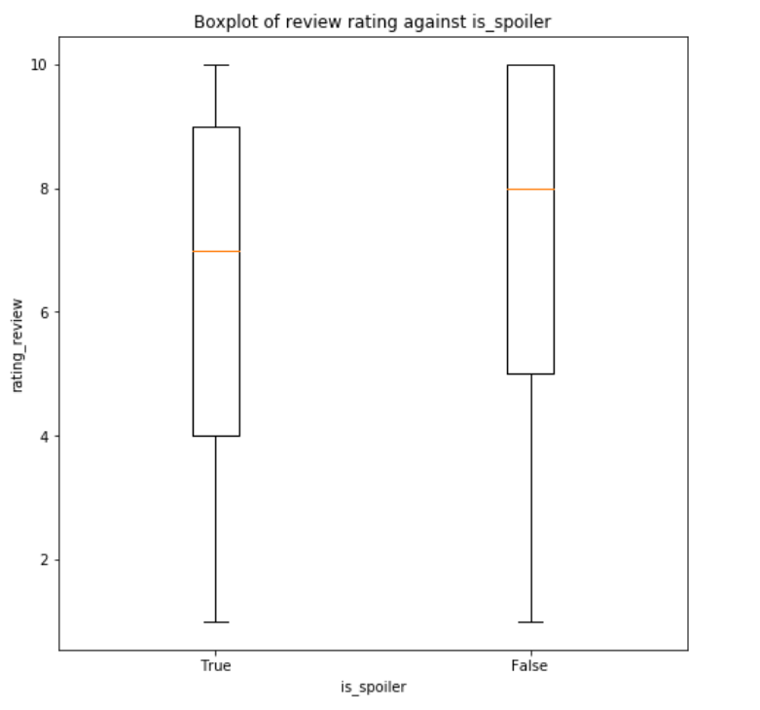
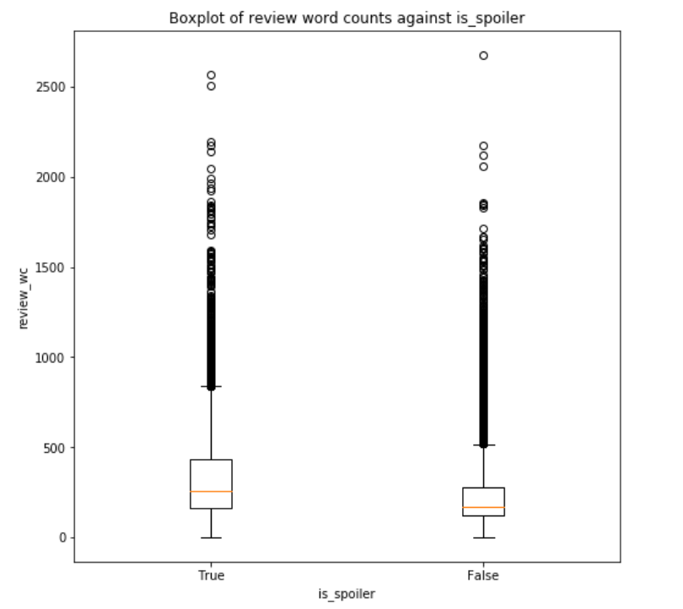
ISSS610 Applied Machine Learning
Project Proposal
Feature Engineering
Review Word Count: spoiler → higher word counts
Review Rating: spoiler → lower ratings
Convert Genre to Dummy Variable
Group 2 | 25 Feb 2020

Slide 12
ISSS610 Applied Machine Learning
Project Proposal
Feature Engineering
Obtain Vector Representation of each Review Text & Plot Synopsis (dimension = 50)
BOW → LSA (truncated SVD)
TFIDF → LSA (truncated SVD)
Doc2Vec - Distributed Bag of Words
Doc2Vec - Distributed Memory Mean
Cosine Similarity of the Review Text against Plot synopsis for each corresponding document vector
Group 2 | 25 Feb 2020

Slide 13
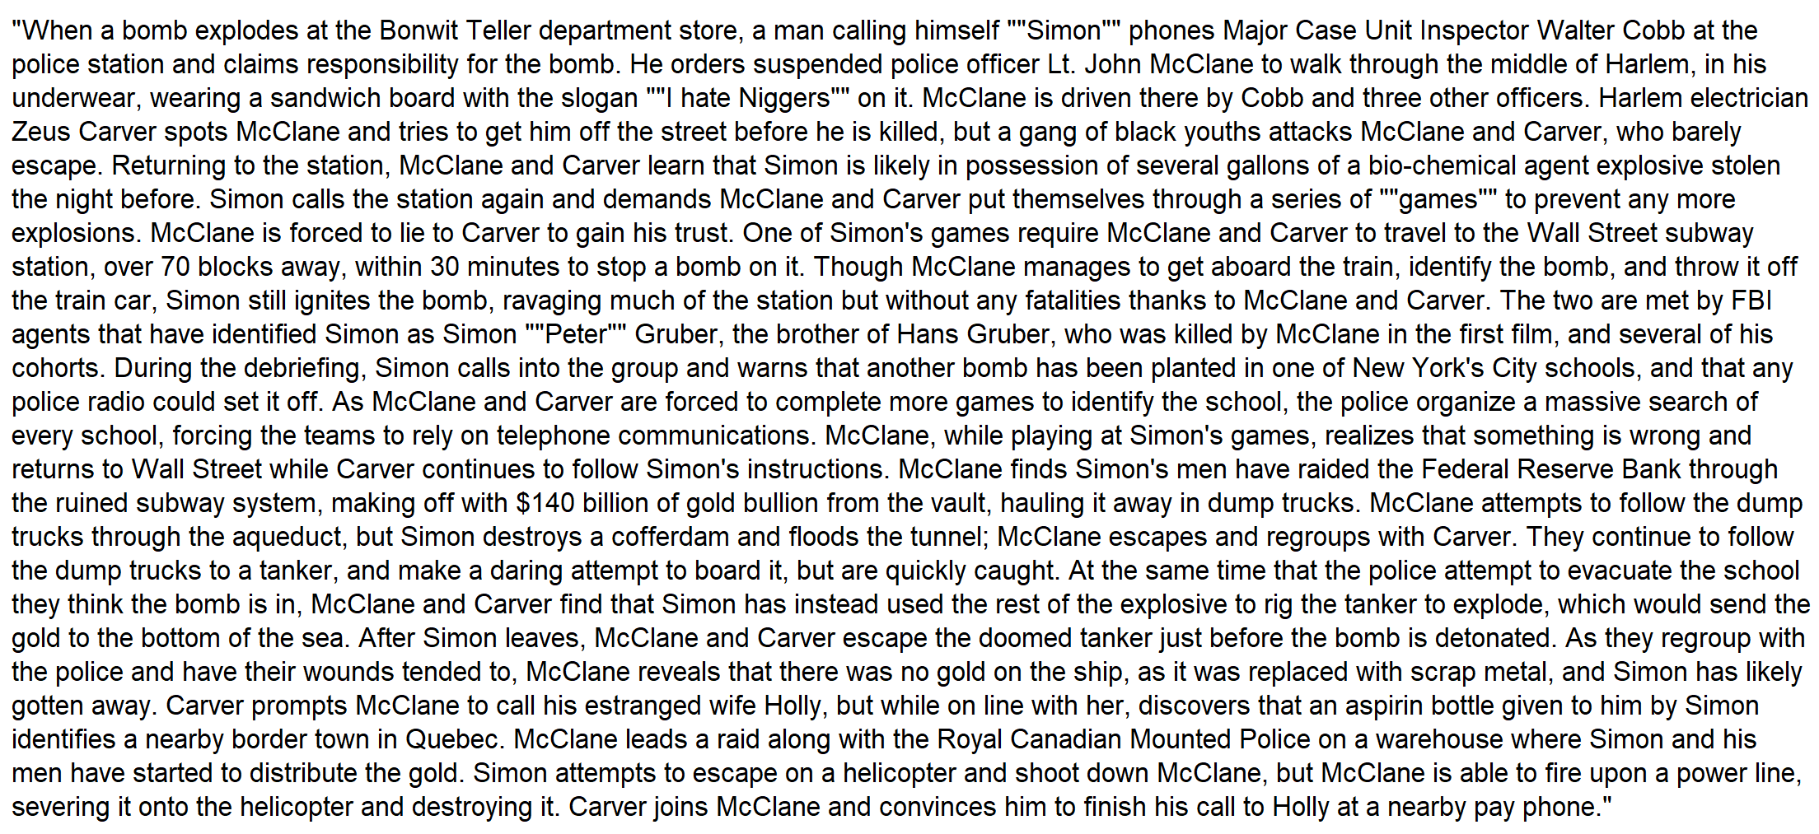
ISSS610 Applied Machine Learning
Project Proposal
Feature Engineering
Example of Plot Synopsis – Contains plot points → spoilers
Group 2 | 25 Feb 2020

Slide 14
ISSS610 Applied Machine Learning
Project Proposal
Features
3 Basic Features:
Review Word Count
Review Rating
Genre’s Dummy Variable (21 dimensions)
4 pairs of Document Vectors and its corresponding Cosine Similarity Features:
BOW_tSVD & sim_BOW
TFIDF_tSVD & sim_TFIDF
d2vDBOW & sim_d2vDBOW
d2vDMM & sim_d2vDMM
Group 2 | 25 Feb 2020

Slide 15
ISSS610 Applied Machine Learning
Project Proposal
Analysis
Logistic Regression Model
Gaussian Naïve Bayes
Random Forest Model
Neural Network
Group 2 | 25 Feb 2020

Slide 16
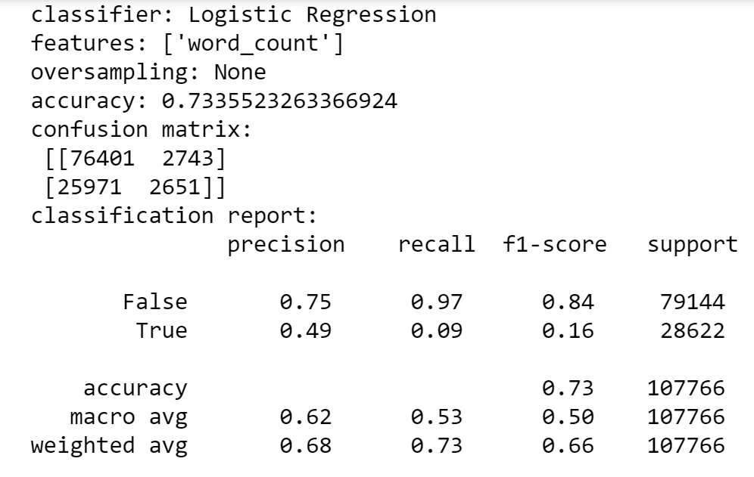
ISSS610 Applied Machine Learning
Project Proposal
Result
Logistic Regression Model
This is what we want to improve on
Group 2 | 25 Feb 2020
Group 2 | 25 Feb 2020

Slide 17
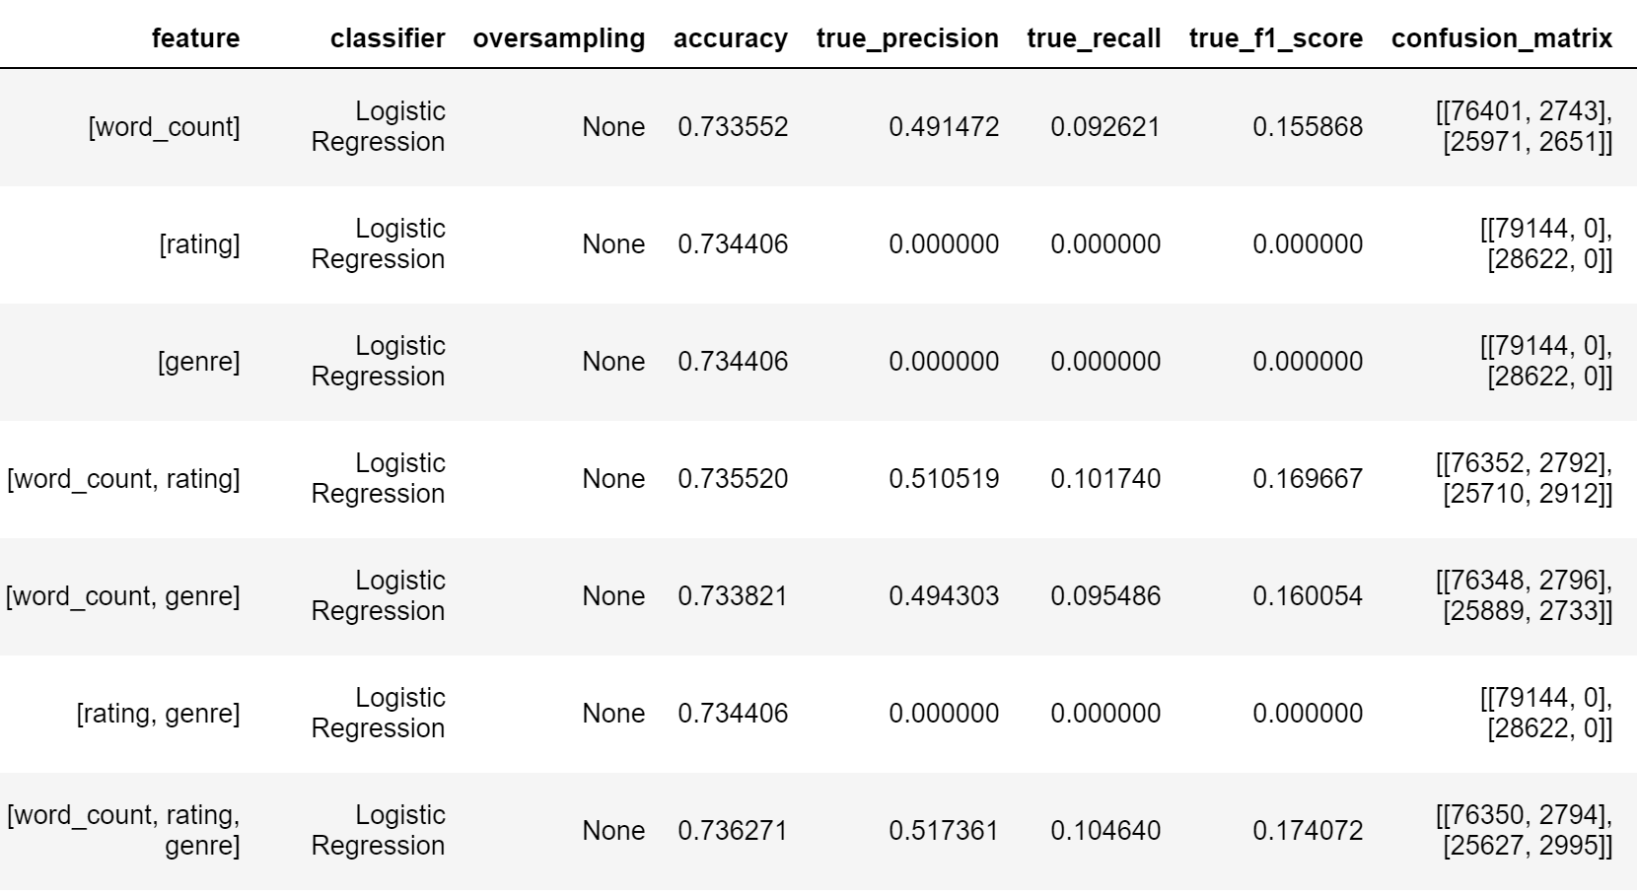
ISSS610 Applied Machine Learning
Project Proposal
Result
Logistic Regression Model
Observations:
Our data is lop-sided (is_spoiler ~27% True, ~73% False), it will achieve good accuracy by predicting all as False.
Review word count seems to be a better feature as compared to rating and genre. However, combining all 3 features give better recall score for the True label.

Slide 18
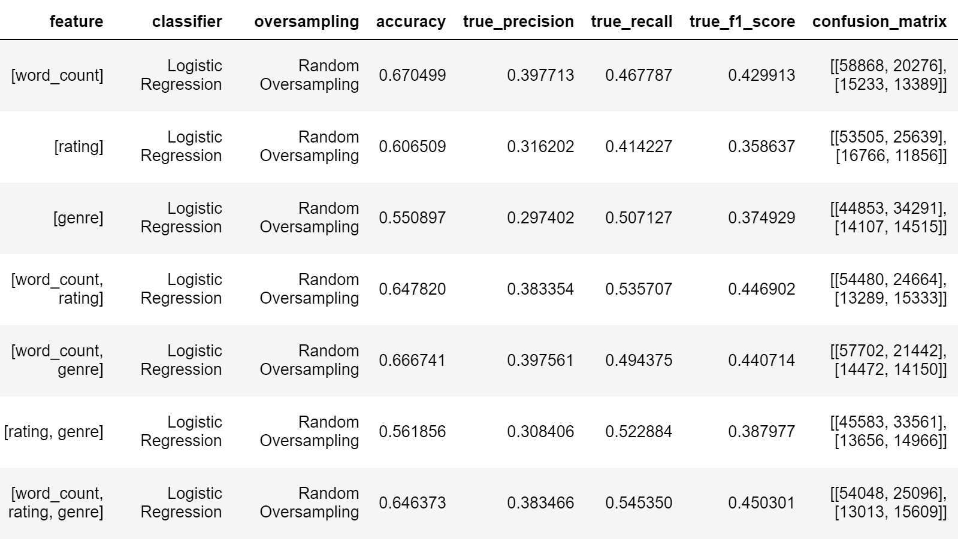
ISSS610 Applied Machine Learning
Project Proposal
Result
Logistic Regression Model (with random oversampling)
Observations:
F1 score & Recall score improve drastically for the True label.
Overall accuracy drops
Using all of the 3 basic features give the best True Recall score

Slide 19
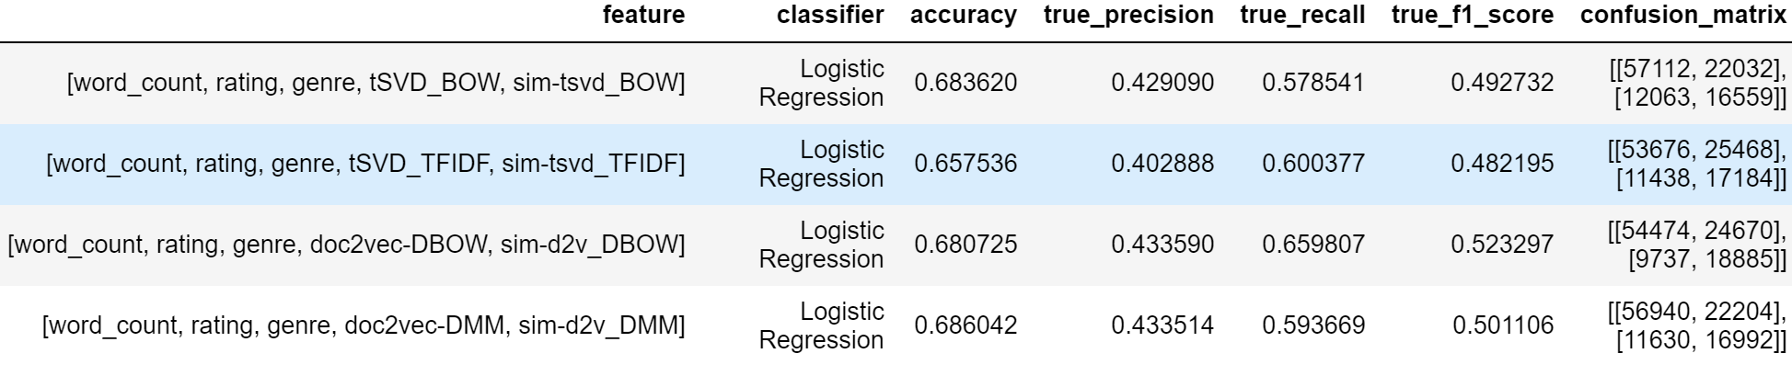
ISSS610 Applied Machine Learning
Project Proposal
Result
Logistic Regression Model (with random oversampling)
Comparison of the 4 Document Vectors
Observations:
Doc2Vec-DBOW give the best True F1 score (52.3%). The True Recall is also high at 65.9%

Slide 20
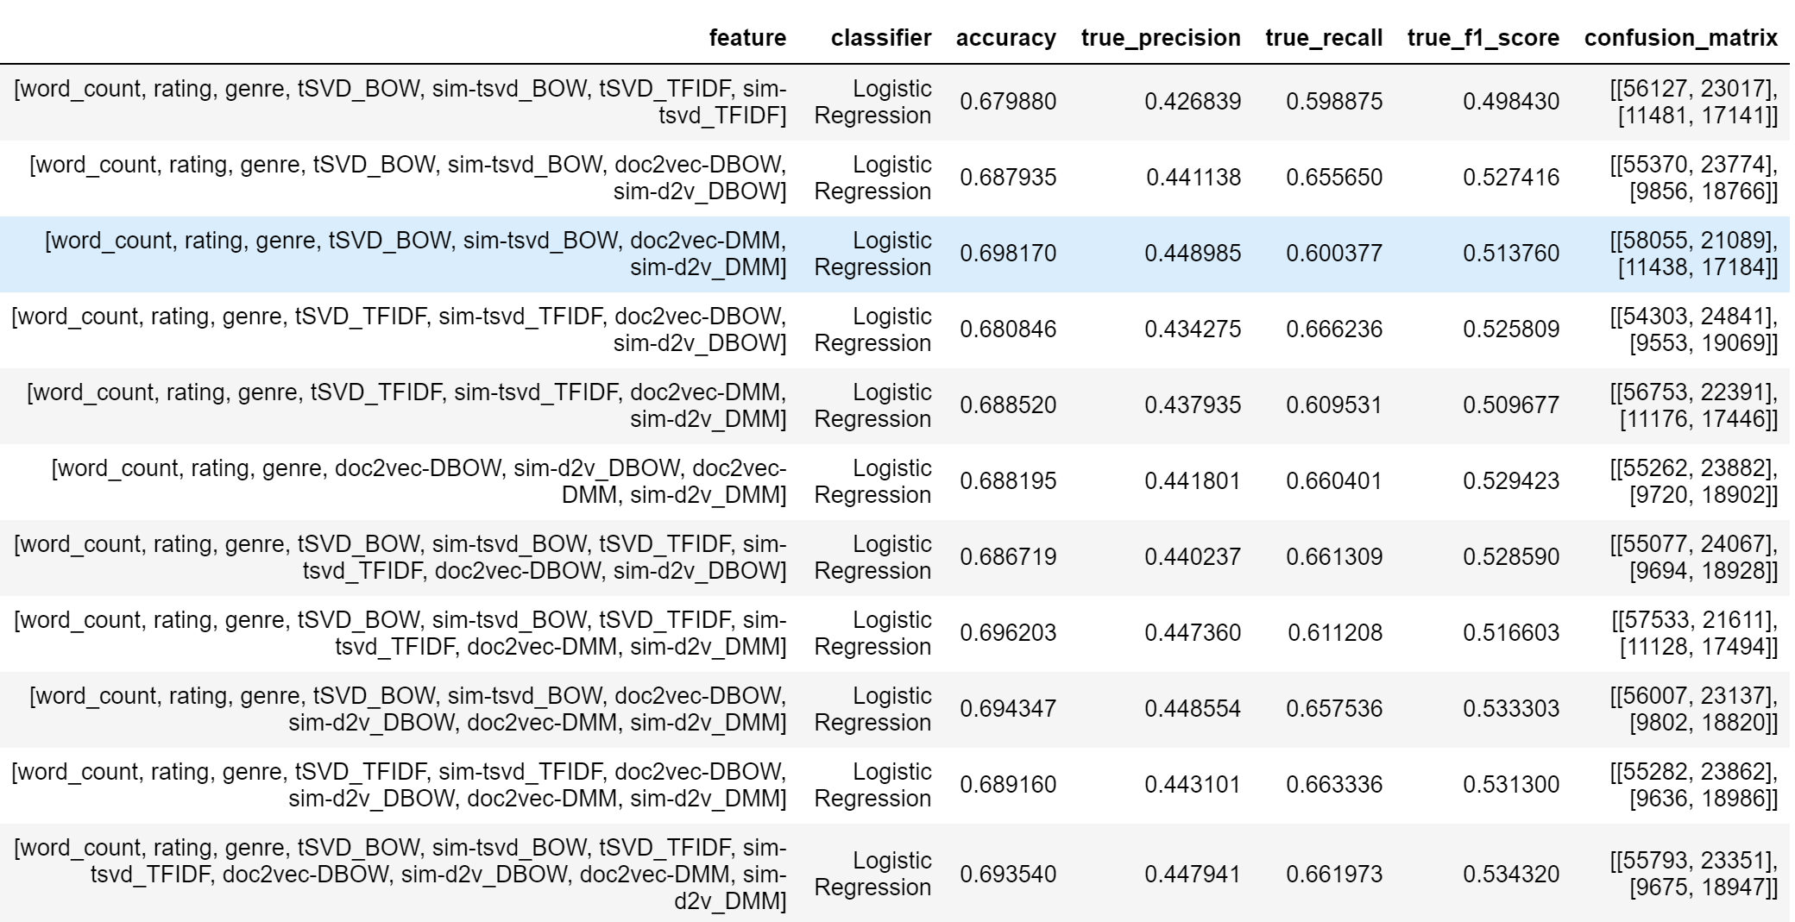
ISSS610 Applied Machine Learning
Project Proposal
Result
Logistic Regression Model (with random oversampling)
All Features Permutations
Observations:
Increasing the number of features does not necessarily improve the True F1 score.
The best True F1 score is ~53.4%, which is not a big improvement from using only 1 Document Vector feature

Slide 21
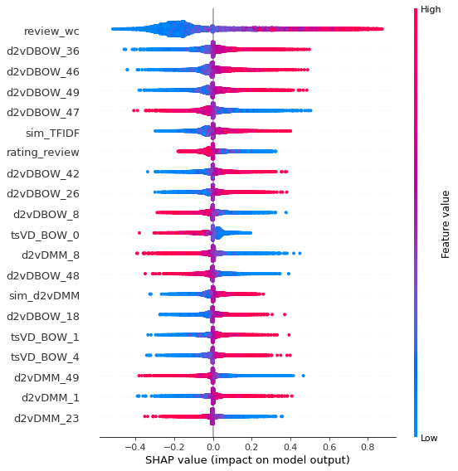
ISSS610 Applied Machine Learning
Project Proposal
SHAP Analysis
Logistic Regression Model with all the features
Run the SHAP analysis using 10,000 test data points.
review word count is really a good feature.
Doc2Vec-DBOW vectors also contribute to the model

Slide 22
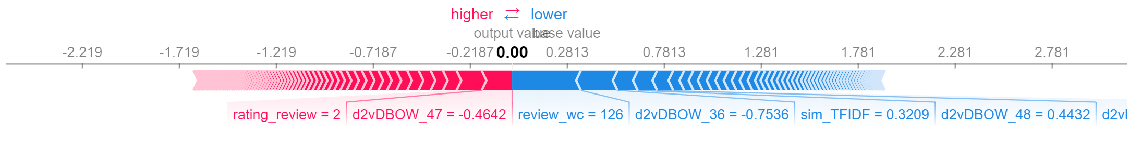
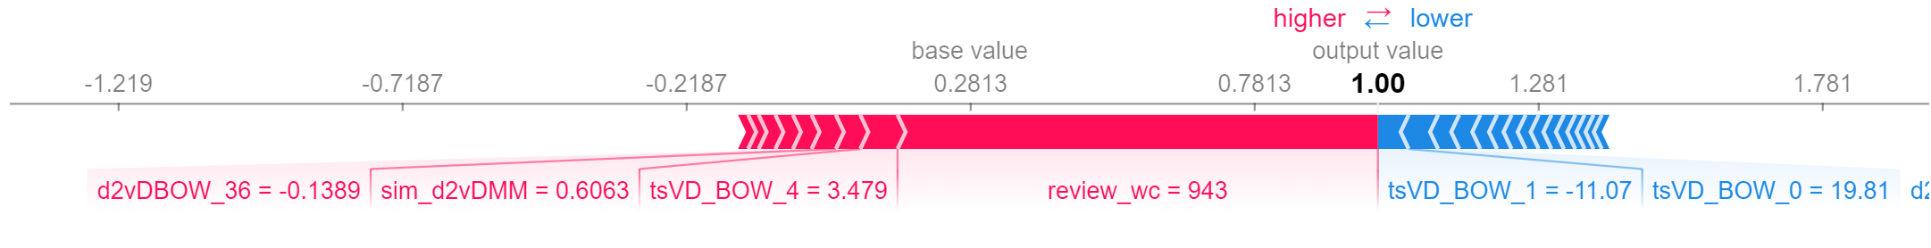
ISSS610 Applied Machine Learning
Project Proposal
SHAP Analysis
Logistic Regression Model with all the features
is_spoiler = FALSE
is_spoiler = TRUE

Slide 23
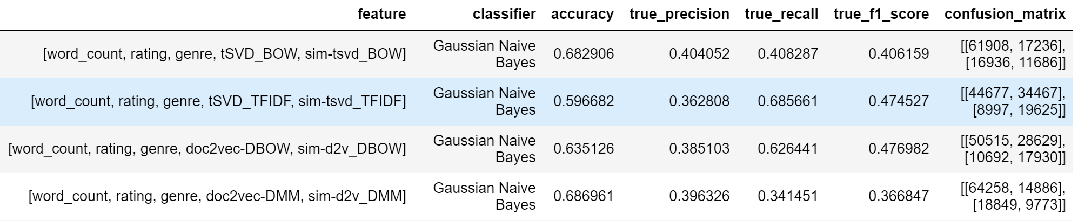
ISSS610 Applied Machine Learning
Project Proposal
Result
Gaussian Naïve Bayes
Observations:
While TFIDF with tSVD and Doc2Vec-DBOW give good True Recall results, their True precision also suffer. Hence, the overall F1 scores are both at around 47%
Group 2 | 25 Feb 2020

Slide 24
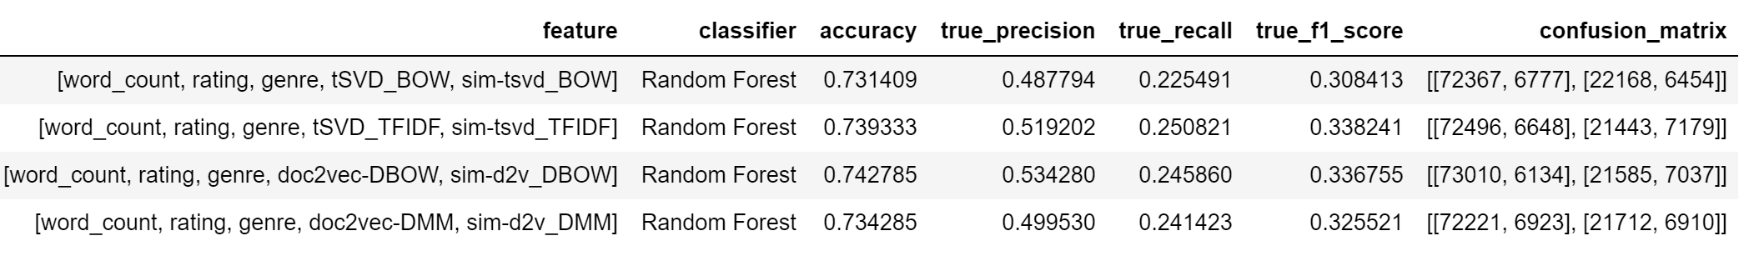
ISSS610 Applied Machine Learning
Project Proposal
Result
Random Forest
Observations:
Random Forest has high accuracy. However, the True F1 score is very low (~30-33%)
In addition, it takes a longer time to run
Group 2 | 25 Feb 2020

Slide 25
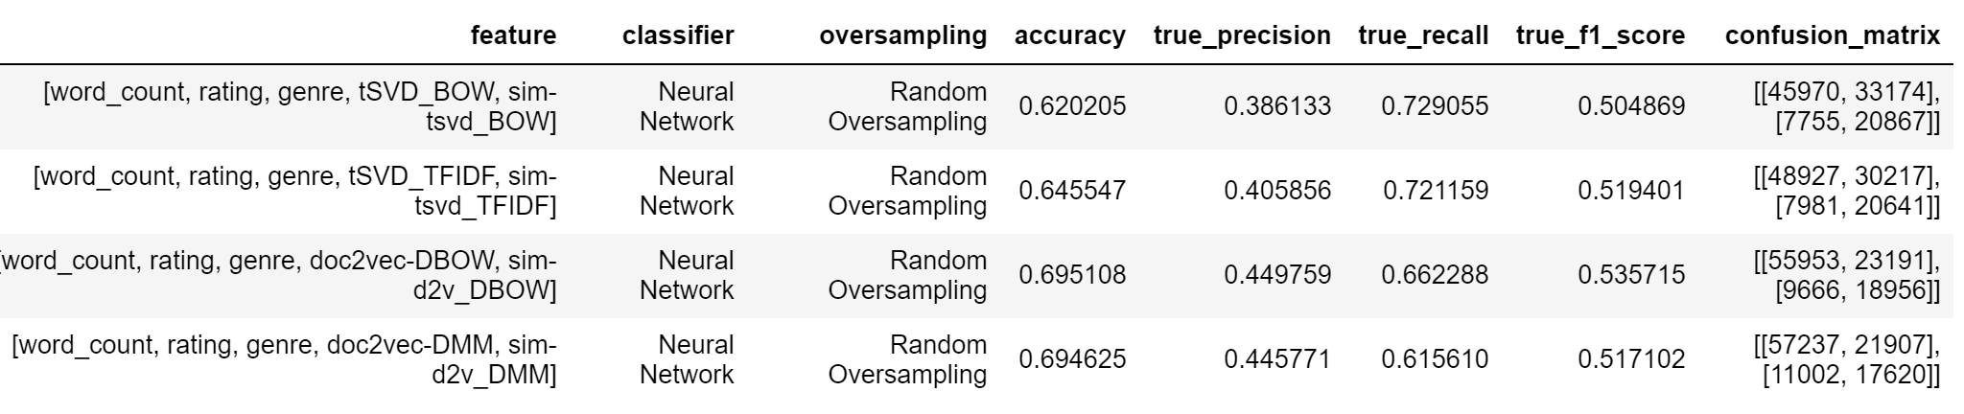
ISSS610 Applied Machine Learning
Project Proposal
Result
Neural Network – 3 x 224-nodes Dense layers and 1 Output layer
Observations:
Neural Networks give the best results as compared to other models
The model with the Doc2Vec-DBOW document vectors give the best result
Group 2 | 25 Feb 2020

Slide 26
ISSS610 Applied Machine Learning
Project Proposal
Result - Summary
Summary of True F1 Score
Features | Logistic Regression | Gaussian Naïve Bayes | Random Forest | Neural Networks
word_count, rating, genre, tSVD_BOW, sim-tsvd_BOW | 0.493 | 0.406 | 0.308 | 0.505
word_count, rating, genre, tSVD_TFIDF, sim-tsvd_TFIDF | 0.482 | 0.475 | 0.338 | 0.519
word_count, rating, genre, doc2vec-DBOW, sim-d2v_DBOW | 0.523 | 0.477 | 0.337 | 0.536
word_count, rating, genre, doc2vec-DMM sim-d2v_DMM | 0.501 | 0.367 | 0.326 | 0.517
Group 2 | 25 Feb 2020

Slide 27
ISSS610 Applied Machine Learning
Project Proposal
Re-test
Manual re-label a subset of the test set with size of 1000
Label is based on whether the reviews have information of the movie plots
 | Original Label | Our Label | Count
No Change in the Label | TRUE | TRUE | 145
 | FALSE | FALSE | 546
 |  | Sub-Total | 691
Change in the Label | TRUE | FALSE | 137
 | FALSE | TRUE | 172
 |  | Sub-Total | 309
Group 2 | 25 Feb 2020

Slide 28
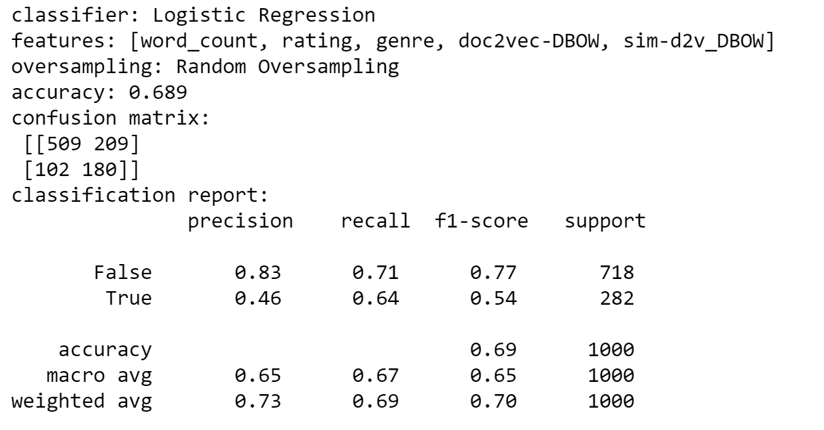
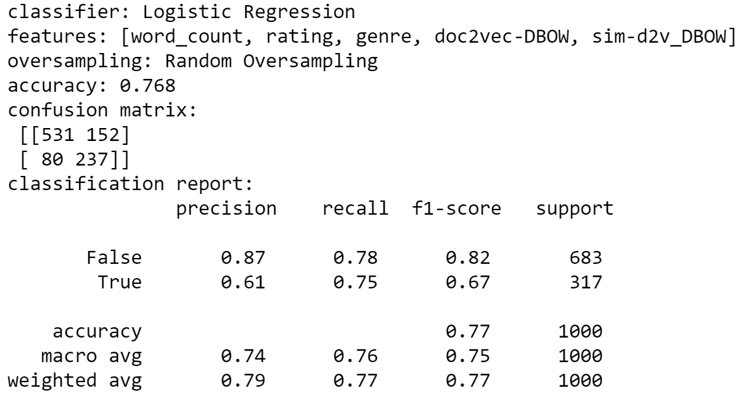
ISSS610 Applied Machine Learning
Project Proposal
Re-test
Logistic Regression
Original Label
Our Label
Group 2 | 25 Feb 2020

Slide 29
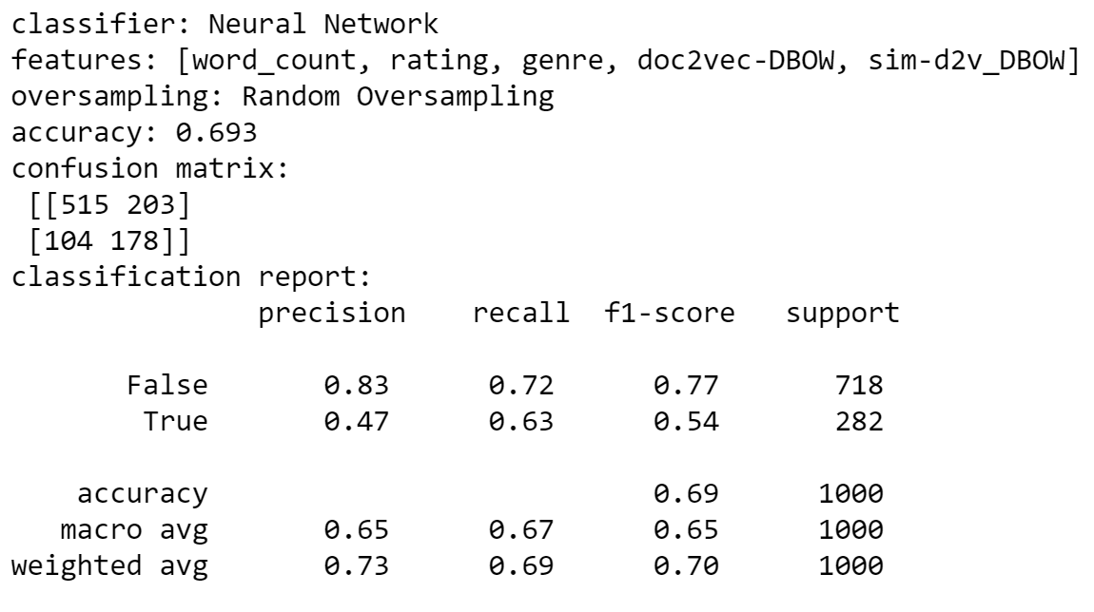
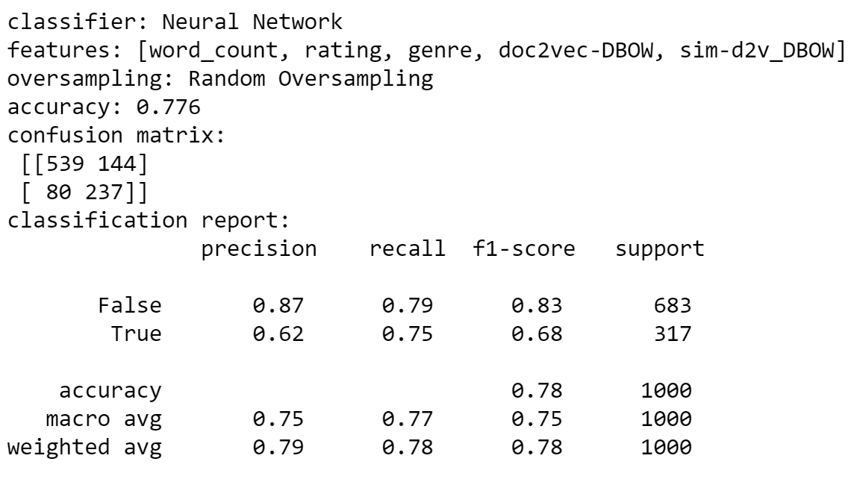
ISSS610 Applied Machine Learning
Project Proposal
Re-test
Neural Network
Original Label
Our Label
Group 2 | 25 Feb 2020

Slide 30
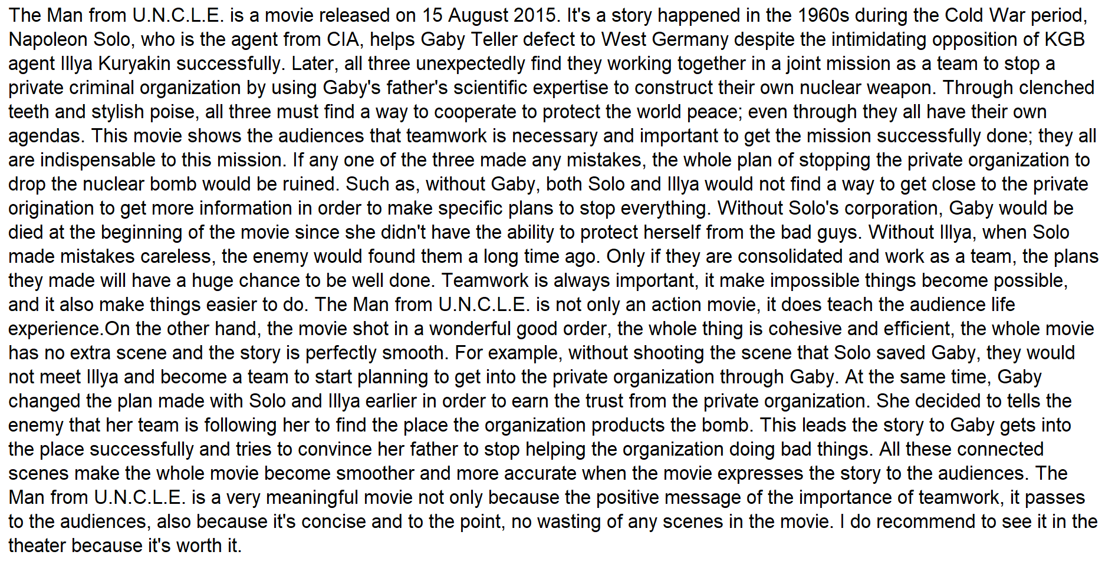




ISSS610 Applied Machine Learning
Project Proposal
Re-test
Example that user labelled as non-spoiler, but is actually spoiler
Group 2 | 25 Feb 2020

Slide 31
ISSS610 Applied Machine Learning
Project Proposal
Conclusion
Logistic Regression and Neural Networks give better results.
Good feature selection is important for good model performance
Group 2 | 25 Feb 2020
Notes:
All movies have between 1 and 3 genres.
If a movie has three genres, it’s count would be included in all three genres.
Verified also that there that the movie released in 1921 was “The Kid” by Charles Chaplin.

Slide 32
ISSS610 Applied Machine Learning
Project Proposal
Conclusion
Spoiler detection is very challenging, since people can write in such ambiguous fashion that even humans can hardly catch it.
Potential Application: IMDB could advise users to change their label more objectively based on whether the review is leaking plots information
Group 2 | 25 Feb 2020
Notes:
All movies have between 1 and 3 genres.
If a movie has three genres, it’s count would be included in all three genres.
Verified also that there that the movie released in 1921 was “The Kid” by Charles Chaplin.

Slide 33
ISSS610 Applied Machine Learning
Project Proposal
Benchmarking
Spoiler Alert: Machine Learning Approaches to Detect Social Media Posts with Revelatory Information [2013]
Vector-base approach using data from TV Tropes
Use Transitive verbs (e.g. “revealed”, “to kill”) and Temporal Expressions (e.g. “in the end”, “end of”) as indicative features of spoilers
Accuracy achieved: 67%
Group 2 | 25 Feb 2020

Slide 34
ISSS610 Applied Machine Learning
Project Proposal
Benchmarking
Fine-Grained Spoiler Detection from Large-Scale Review Corpora [2019]
Built spoilernet on top of the Hierarchical attention network (HAN)
Use document frequency-inverse item frequency (DF-IIF) to identify document-specific terms.
Train, validated and tested using Goodreads dataset.
Tested also against the TV Tropes dataset.
Accuracy achieved: 73.7%
Group 2 | 25 Feb 2020
Notes:
“Spoiler analysis and detection is a relatively unexplored topic”
Acknowledge inconsistency in some Spoiler Tags
Hard to benchmark against, because the datasets are quite different.

Slide 35
ISSS610 Applied Machine Learning
Project Proposal
Closing Remarks
Spoiler?
Group 2 | 25 Feb 2020

Slide 36
‘SPOILER ALERT!!!’
Thank you!

